Slide 1
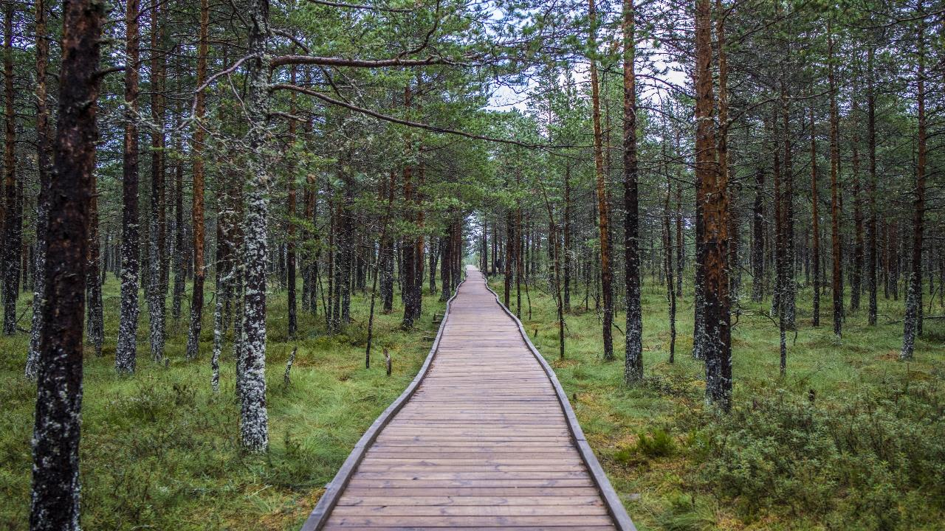
Estonian tourism „new normal“
Liina Maria Lepik
Director of Estonian Tourist Board

Slide 2
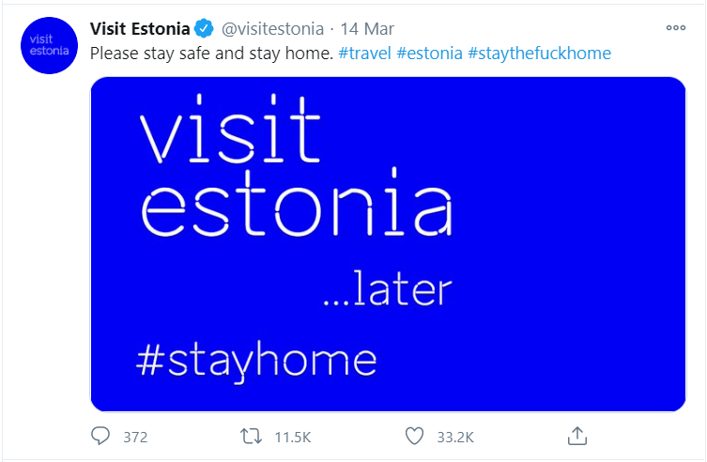

Slide 3
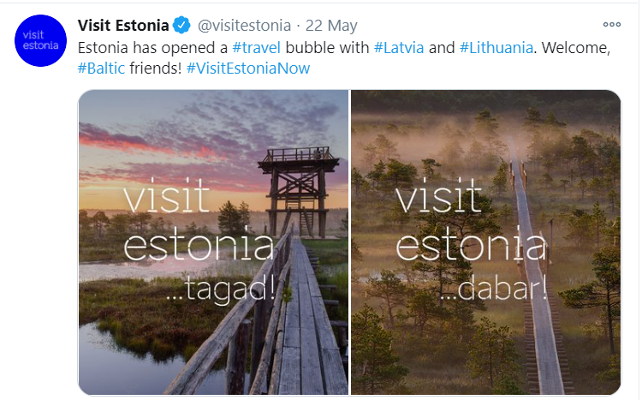

Slide 4
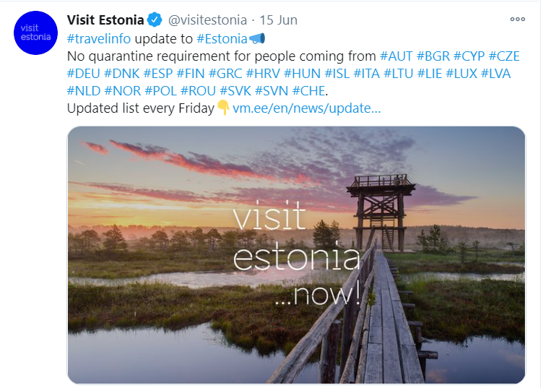

Slide 5
5 campaigns in summer
+ domestic
+ Finland
+ Latvia
2 Latvian co-campaigns

Slide 6
tourism decline - total (%) January to August, 2020 (YoY)
Estonia -45%
average price -30%
TALLINN
-59%
HARJUMAA
-45%
LÄÄNE-VIRUMAA
-34%
IDA-VIRUMAA
-31%
HIIUMAA
-9%
LÄÄNEMAA
-26%
RAPLAMAA
-28%
JÄRVAMAA
-30%
JÕGEVAMAA
-19%
total overnights
decline:
PÄRNUMAA
-36%
TARTUMAA -45%
More than -50%
SAAREMAA
-30%
PÄRNU
-38%
VILJANDIMAA
-27%
TARTU
-47%
-41...-50%
-31...-40%
PÕLVAMAA
-4%
-21...-30%
0...-15%
VALGAMAA
-34%
VÕRUMAA
-29%

Slide 7
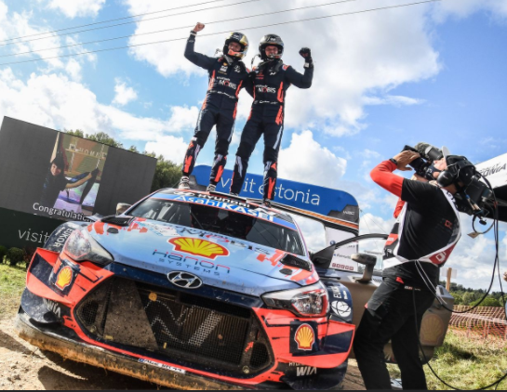
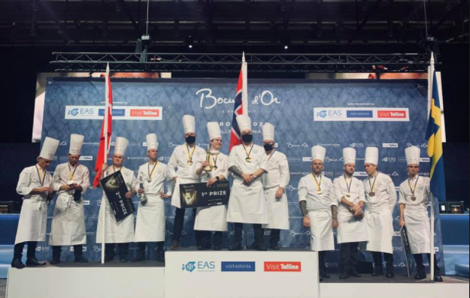
making impossible possible – big international events

Slide 8
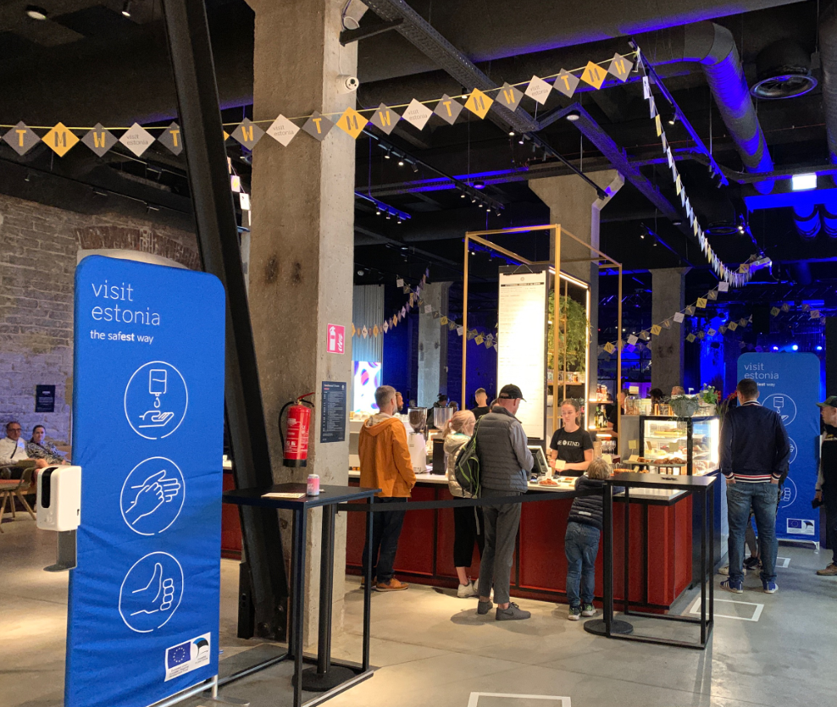
safety label and desinfection stations
You are safe here –
destination recmmends, company confirms
YOU
ARE SAFE HERE

Slide 9
state aid for tourism
business model support
(4+4 mEUR)
wage support (march – june)
direct support (25 + 5 mEUR)
support for events and conferences with new terms
(2 mEUR)
no participation fee in workshops
destinations to DMOs
(0,8 mEUR)

Slide 10
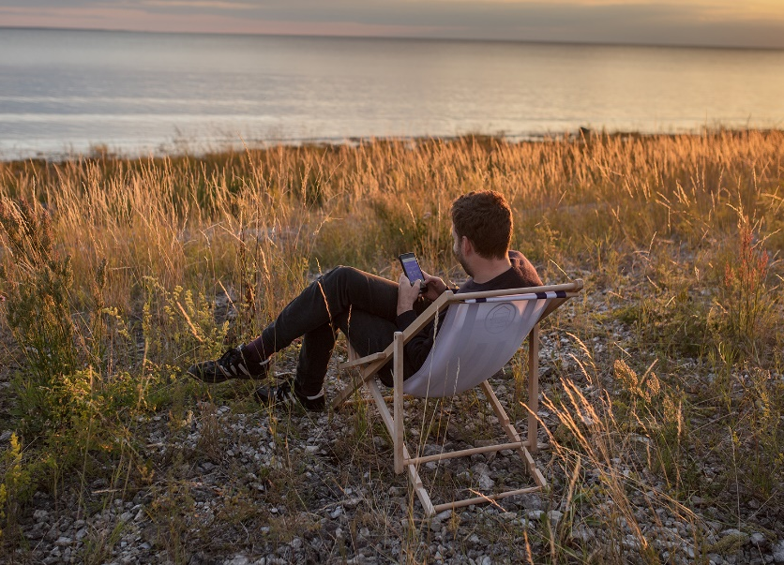
engaging sector
Research:
business opportunities for Estonian tourism sector (80 interviews in summer 2020)

Slide 11
our priorities
short term: campaigns (when possible) and a „translator“ between sector and government
long term: crisis as an opportunity
smooth customer journey
hospitality
5-8 DMOs
renewed business models
digital solutions
sustainable tourism

Slide 12
Thank you!
Liina Maria Lepik
Liinamaria.lepik@eas.ee

